Slide 1

Aspiration Vision Board

Slide 2

How to Use Your Aspiration Vision Board

Slide 3

Focus Your Vision with Intention

Slide 4
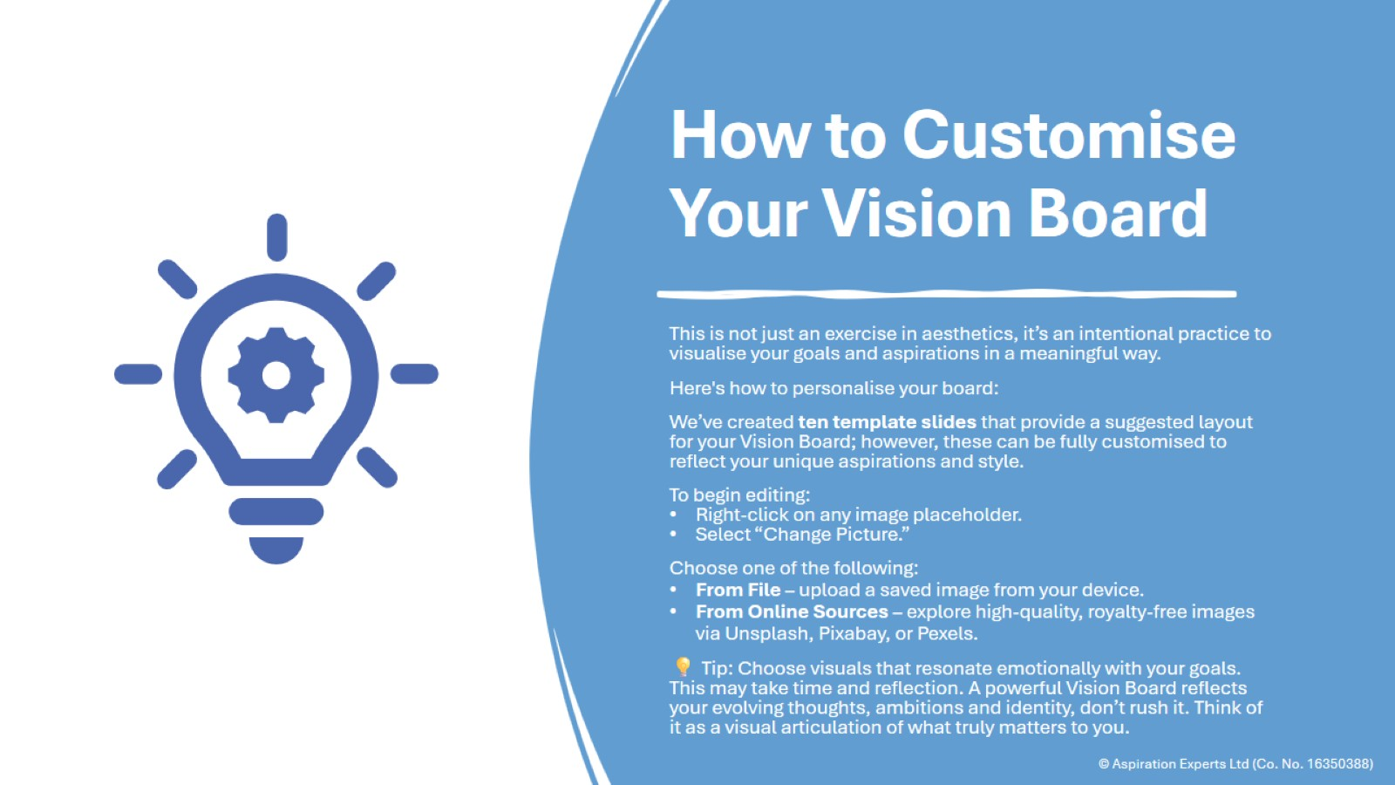
How to Customise Your Vision Board

Slide 5
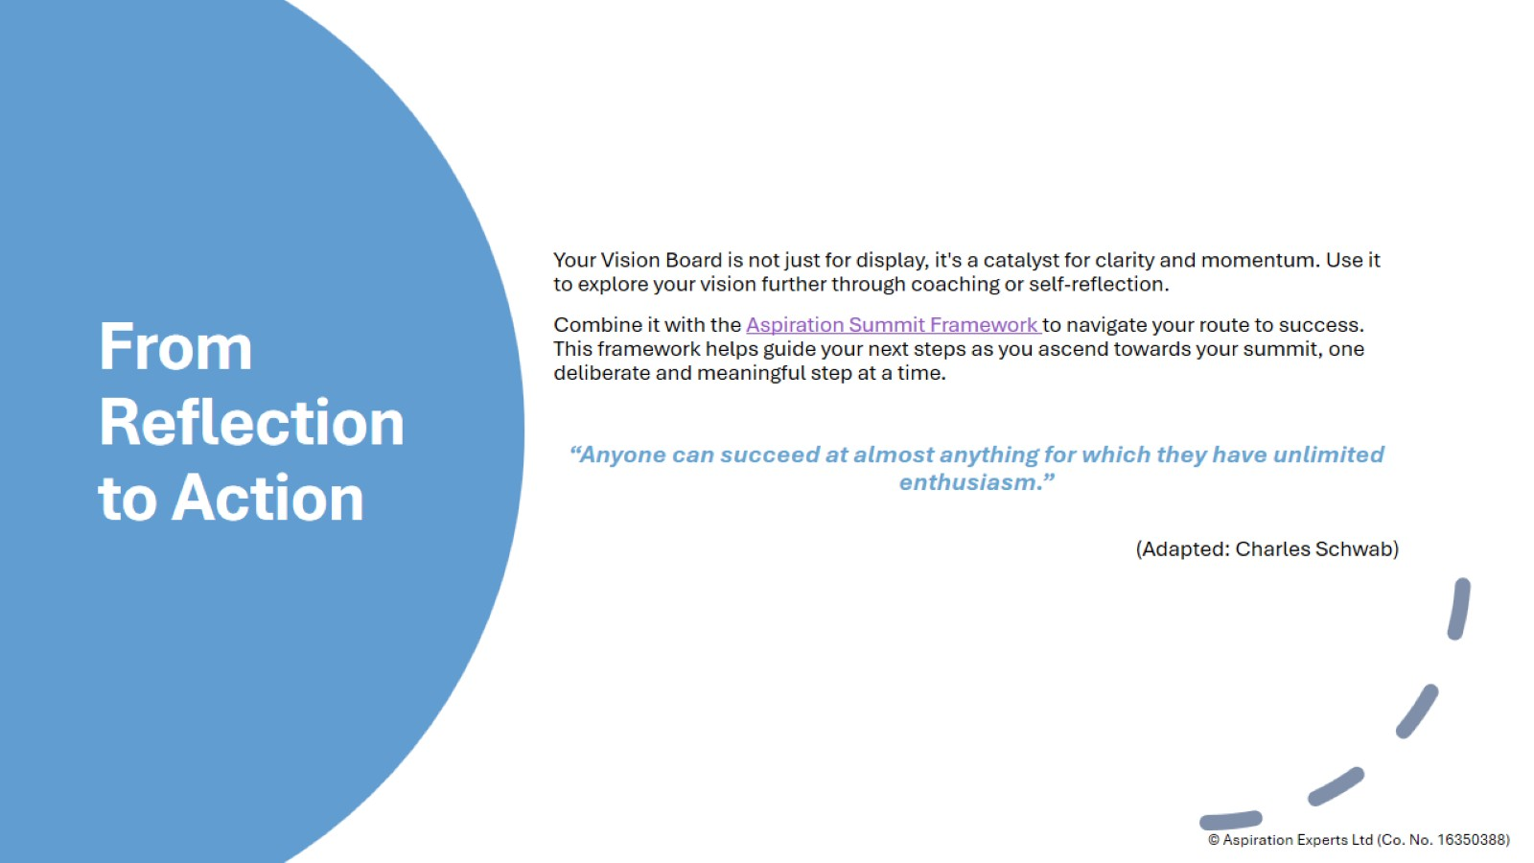
From Reflection to Action

Slide 6
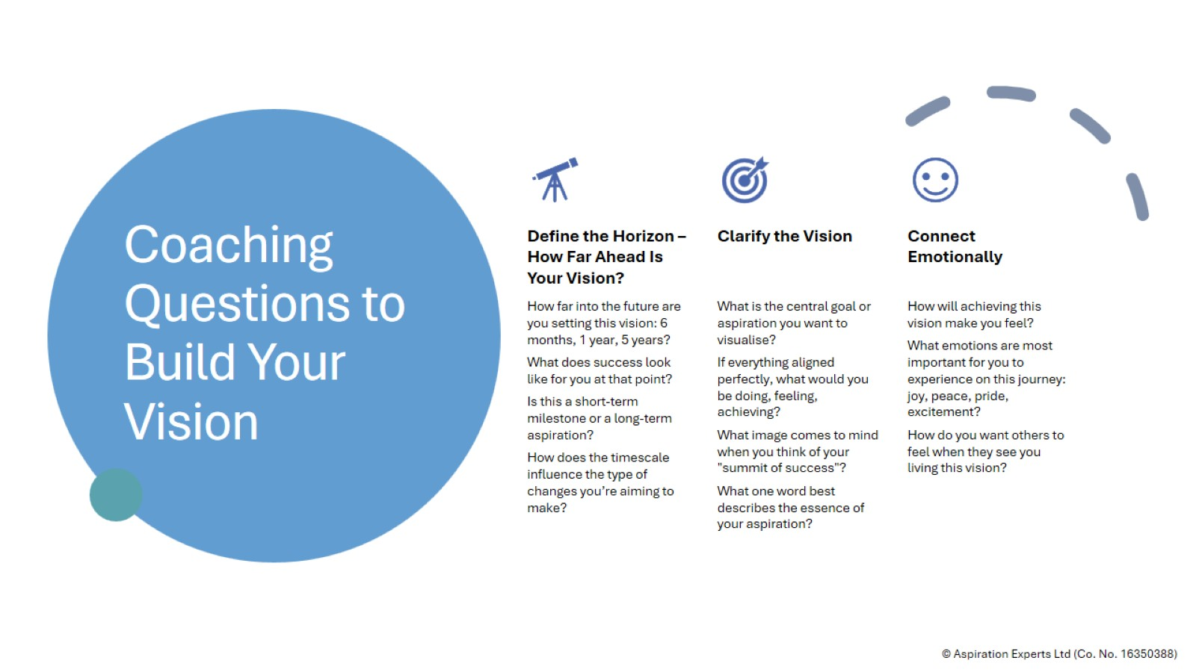
Coaching Questions to Build Your Vision

Slide 7
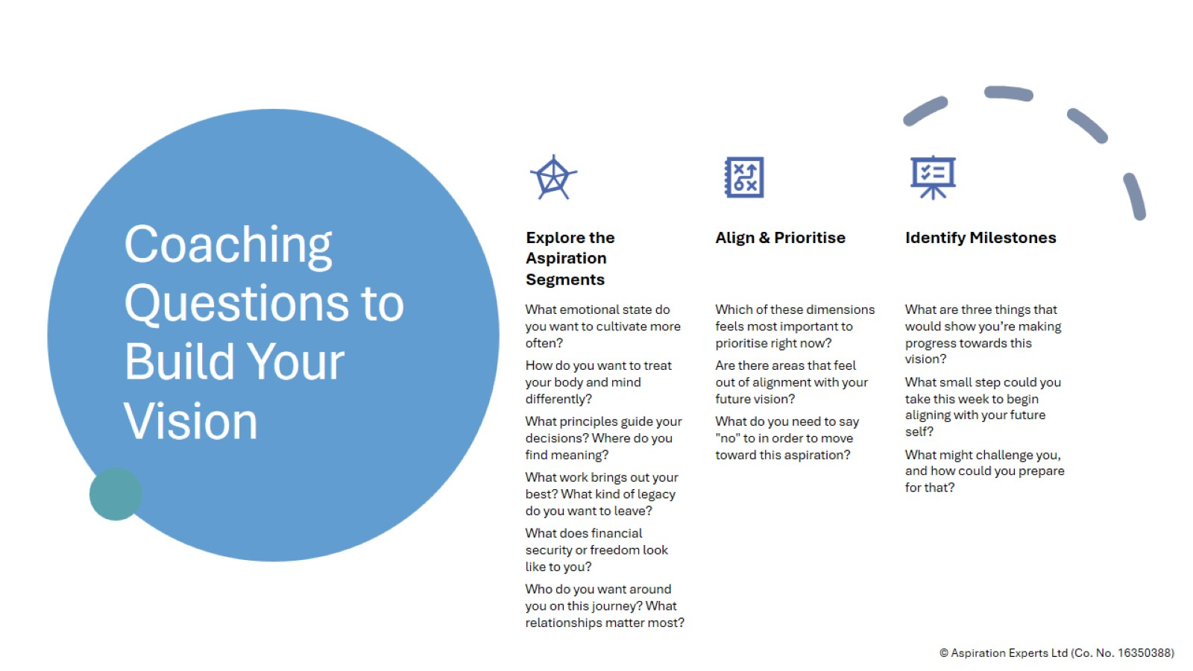
Coaching Questions to Build Your Vision

Slide 8
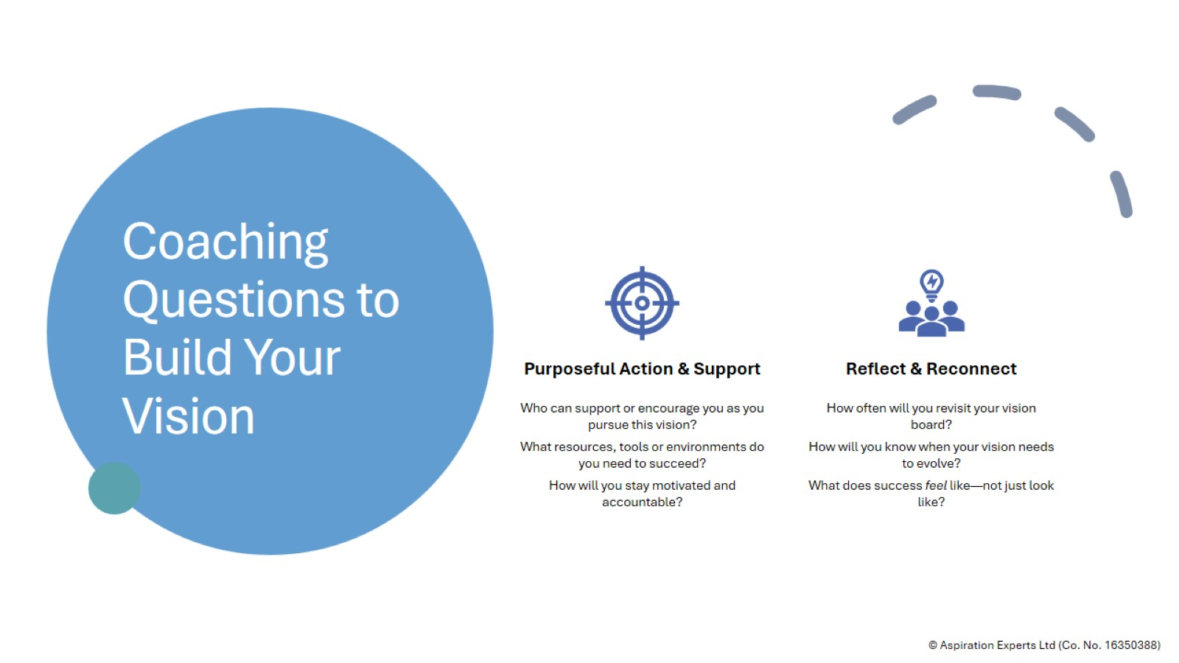
Coaching Questions to Build Your Vision

Slide 9


Slide 18
© Aspiration Experts Ltd (Co. No. 16350388)

Slide 19


